Slide 1

AlphaGo Zero Algorithm
Tutorials on alphago zero

Slide 2
So Far
We have discussed:
Monte Carlo Tree Search
Residual Networks
These two are the major building blocks of the AlphaGo Zero Algorithm.
Let’s combine these two and explain the algorithm!

Slide 3
Comparison with AlphaGo
Trained solely by self-play reinforcement learning starting from random play, without any supervision or human expert data
Only Input → Black and White stones on the board
Uses a single Neural Network → combines the policy network and the value network into a single network.
Uses Simpler Tree Search → Monte-Carlo Tree Search only relies on this single neural network to evaluate positions and sample moves → no random rollouts this time!

Slide 4
Combining MCTS + Neural Net
Essentially, this new reinforcement learning algorithm incorporates the Monte-Carlo Tree Search inside the Training Loop for the Neural Network!
Let’s revisit these components, now in a way that we are able to check how they relate to each other.

Slide 5
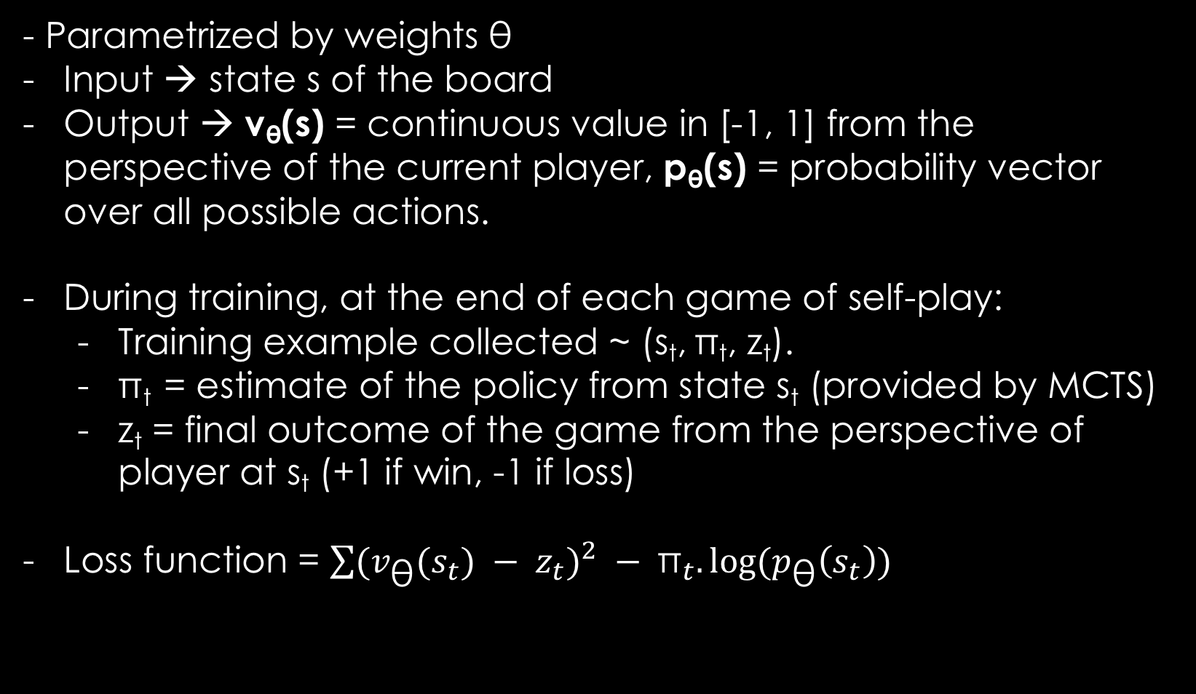
Neural Network
- Parametrized by weights θ
Input → state s of the board
Output → v_{θ}(s) = continuous value in [-1, 1] from the perspective of the current player, p_{θ}(s) = probability vector over all possible actions.
During training, at the end of each game of self-play:
Training example collected ~ (s_{t}, π_{t}, z_{t}).
π_{t} = estimate of the policy from state s_{t} (provided by MCTS)
z_{t} = final outcome of the game from the perspective of player at s_{t} (+1 if win, -1 if loss)
Loss function = ${\sum{(v_{\text{θ}}(s_{t}}) − z_{t})}^{2} − {\text{π}}_{t}.log⁡(p_{\text{θ}}\left(s_{t}\right))$

Slide 6
MCTS for Policy Improvement
We wish to improve p_{θ} estimate from the neural network during the training phase → achieved by MCTS
Starting with an empty search tree, we expand the search tree one node (state) at a time
When a new node is encountered, instead of performing a rollout, the value of the new node is obtained from the NN.
The value is then propagated up the search path

Slide 7
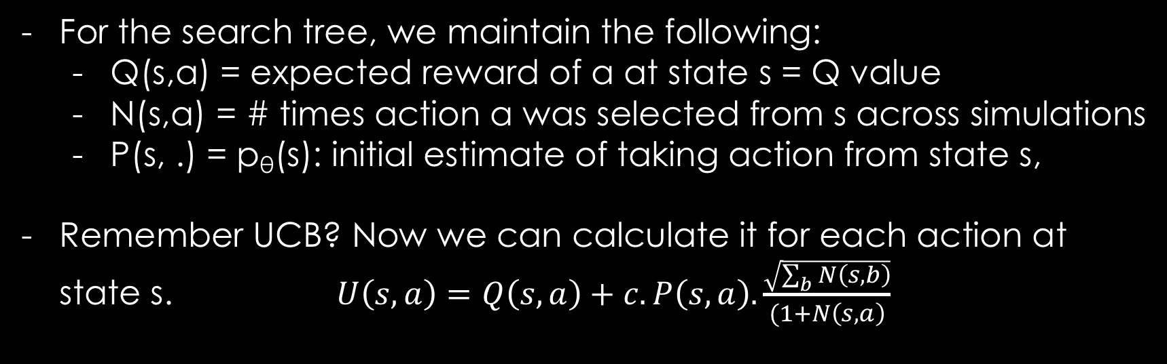
MCTS for Policy Improvement
For the search tree, we maintain the following:
Q(s,a) = expected reward of a at state s = Q value
N(s,a) = # times action a was selected from s across simulations
P(s, .) = p_{θ}(s): initial estimate of taking action from state s,
Remember UCB? Now we can calculate it for each action at state s. $U\left(s,a\right)=Q\left(s,a\right)+c.P\left(s,a\right). \frac{\sqrt{\sum_{b}{N\left(s,b\right)}}}{(1+N\left(s,a\right)}$

Slide 8
MCTS for Policy Improvement
To use MCTS to improve NN initial policy p_{θ}:
Initialize our empty search tree with s as root
Perform a fixed number of simulations:
Each simulation:
Compute action a that maximizes UCB
If the next state s’ (obtained by playing action a on s) exists in the tree, recursively call search on s’
If s’ doesn’t exist, add it to the tree and initialize P(s’, .) = p_{θ}(s’) and v(s’) = v_{θ}(s’) from NN, Q(s’,a) = 0, N(s’, a) = 0 for all actions from s’.
Propagate v(s’) up and update Q(s,a) values.
If we encounter terminal state, propagate up the actual reward (+1, -1)

Slide 9
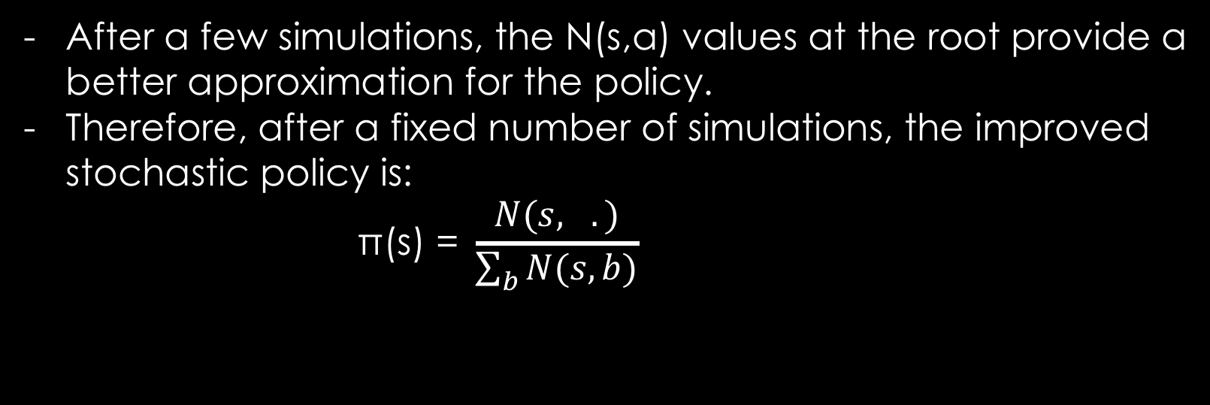
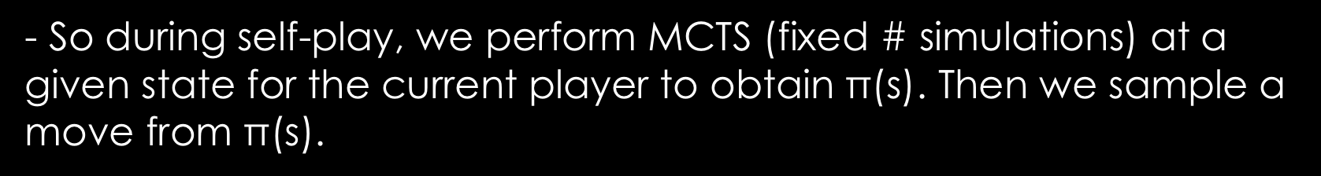
MCTS for Policy Improvement
After a few simulations, the N(s,a) values at the root provide a better approximation for the policy.
Therefore, after a fixed number of simulations, the improved stochastic policy is:
$$\text{π}\text{(}\text{s}\text{) = }\frac{N(s, .)}{\sum_{b}{N(s,b)}}$$
- So during self-play, we perform MCTS (fixed # simulations) at a given state for the current player to obtain $\text{π}\text{(}\text{s}\text{)}$. Then we sample a move from $\text{π}\text{(}\text{s}\text{)}$.

Slide 10
Policy Iteration through Self-Play
So far, we have just looked at the algorithm locally – what happens in each turn of a game.
Learning through self-play = policy iteration algorithm
Let’s understand the training process and hence this policy iteration algorithm!

Slide 11

Policy Iteration through Self-Play
Initialize the NN with random weights (random policy and value networks)
In each iteration:
Play a fixed number of games of self-play
In each turn of single game:
Perform a fixed number of MCTS simulations starting from the current state s_{t} to get ${\text{π}\text{(}\text{s}}_{t})$.
Then pick a random action from ${\text{π}\text{(}\text{s}}_{t})$
We get training example (s_{t,} ${\text{π}\text{(}\text{s}}_{t})$, _) ; reward _ is filled at the end of the game
At the end of iteration, NN is trained from obtained training examples
Old vs New NN, if new wins 55% of the time. NN = New NN.

